Slide 1
CMP 2203
LECTURE 4

Slide 2
Combinational Logic circuits
What is a combinational logic circuit? (Lecture1!)
At any one time the logic level at the output depends on a combination of logic levels at the inputs
No memory – output depends on only the current value of its inputs

Slide 3
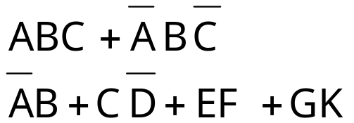
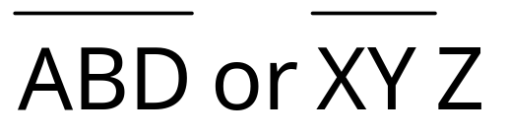
SUM-OF-PRODUCTS
Needed for simplification and design of logic circuits
E.g.
Consist of two or more AND terms (products) that are ORed together
Each AND term consists of one or more variables individually appearing in complement or uncomplemented form
In SOP, one inversion sign cannot cover more than one variable e.g.
✗

Slide 4
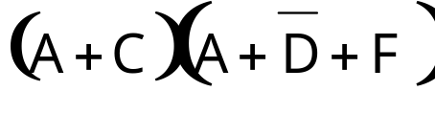
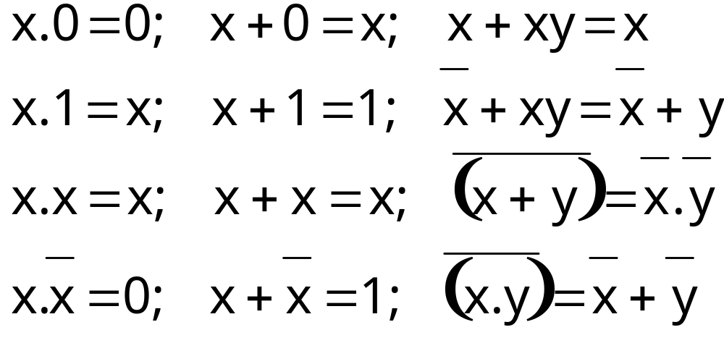
Product-of-sums
Two or more OR terms (sums) ANDed together e.g.
Recall Boolean Theorems:

Slide 5
Simplifying Logic Circuits
Algebraic Method
Use Boolean theorems from lecture 2
Trial and error: no easy way to tell if expression is in its simplest form and not obvious which theorems need to be applied ➔ loads of practice!
Question: why is it important to simplify?
Reduce number of gates and connections so:
Smaller, cheaper, reliable- less connections hence less potential circuit faults

Slide 6
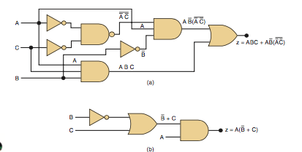
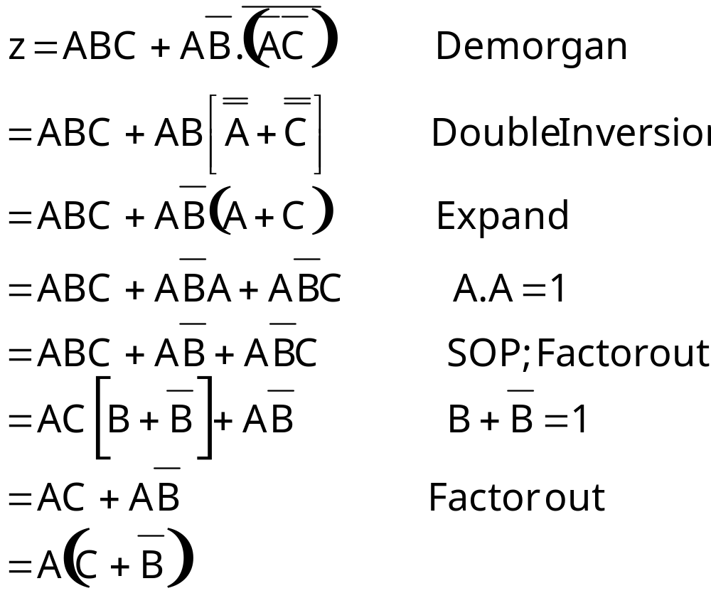
Example 1

Slide 7
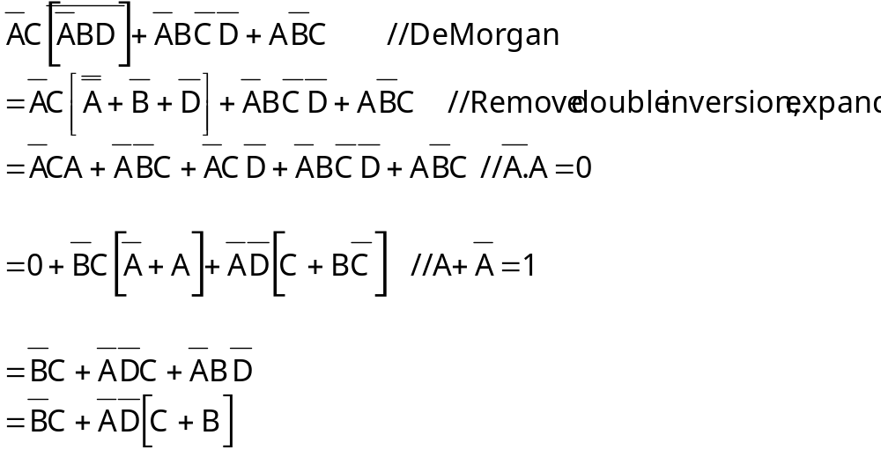
Example 2
** Note; in your exam, highlight which theories you have applied. Do not subject the examiner to guesswork! You will get zero points!
This is in fact not the simplest form of this equation but no way to proceed further from this step

Slide 8
Designing Combinational Logic Circuits
1. Set up the truth table
2. Write AND term for each case where output is 1
3. Write SOP expression for the output
4.Simplify the output expression
5. Implement the circuit

Slide 9

Example
Consider a computer system with two data sources A and B. A selection signal C is applied such that the output is A when C=0 and the output is B when C=1. Design a Logic Circuit to implement this.
C | A | B | X
0 | 0 | 0 | 0
0 | 0 | 1 | 0
0 | 1 | 0 | 1
0 | 1 | 1 | 1
1 | 0 | 0 | 0
1 | 0 | 1 | 1
1 | 1 | 0 | 0
1 | 1 | 1 | 1
AND
0
0
0
0
0
0
0
1
TRUTH TABLE
SOP:
Recall AND gate output is 0 when any one input is 0 ; So to get 1, invert variables which are 0.
Notes:
AND GATE: 0- WHEN ANY OUTPUT IS ZERO

Slide 10
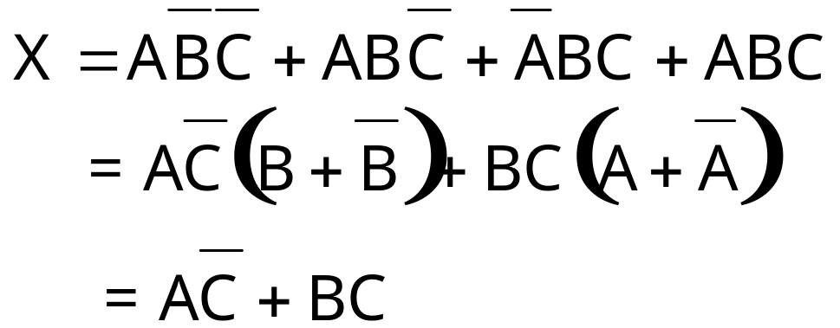
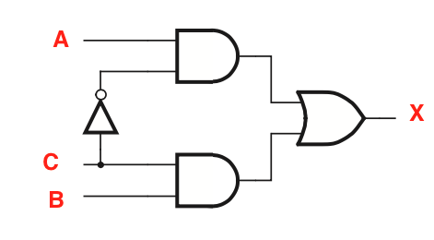
Example

Slide 11
Design of Logic Circuits
Manual process illustrated above is for small circuits
More complex circuits are done by help of CAD tools
Design: conceive what circuit is supposed to do → draw schematic (logic gates + wire connections) → write source code in a hardware description language
Hardware Description Languages: (HDL)
Similar to computer program but used to describe hardware instead of an executable program
2 IEEE standards: VHDL (Very High speed Integrated Circuit HDL) and Verilog HDL

Slide 12
Design of Logic Circuits
Synthesis
Takes initial specification (schematic or HDL code) and outputs logic expressions to describe the logic functions needed to realize the circuit
Then optimize to generate a more efficient and optimal circuit
Functional Simulation
Simulate circuit to verify functioning as expected
Physical Design
Determine how to implement circuit on a chip: how to place logic elements, wiring etc

Slide 13
Design of Logic Circuits
Timing Simulation
Electronic circuits (or any circuits) can not produce instantaneous outputs
It takes a finite amount of time from a change in an input to a corresponding change at the output → Propagation delay
Each logic element needs some time to respond to a change in input
Delay resulting from signals propagating through wires connecting the various logic elements
Propagation delay affects speed of operation of circuit
Timing simulator evaluates expected delays
Designer can then optimize synthesis or initial design
Chip Configuration
Implementation on chip

Slide 14
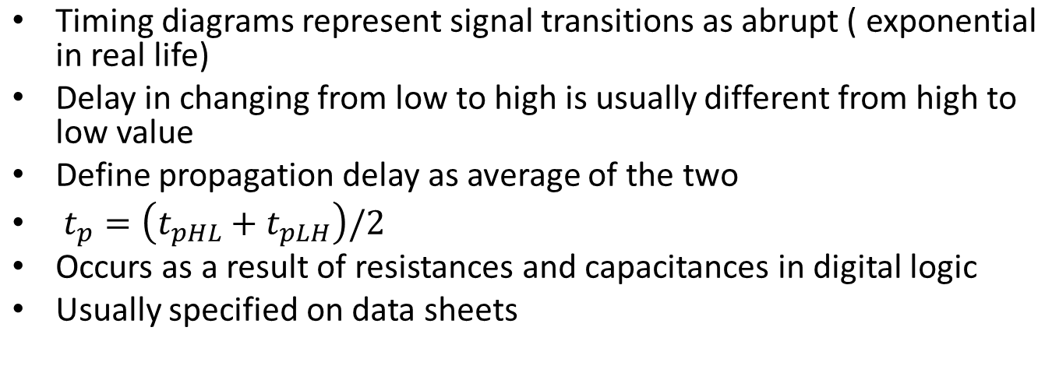
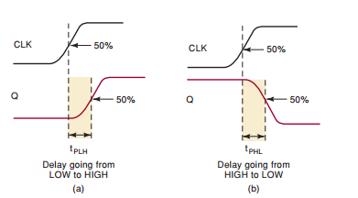
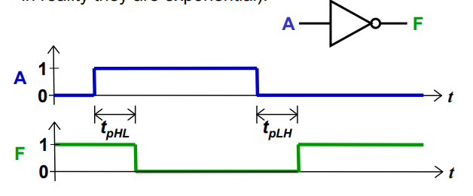
Propagation Delay in timing Diagrams
Source:http://www-inst.eecs.berkeley.edu/~ee40/fa03/lecture/lecture31.pdf source: tocci
Homework: read further

Slide 15
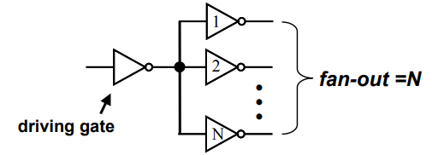
Fan-in and Fan-out in Logic Gates
Fan-in is the number of inputs to the gate
Fan-out is the number of other gates that a specific gate drives i.e. number of gates connected to the output of the “driving gate”
Increases capacitive load on the driving gate and thus longer propagation delay
Homework: Read this further (Chapter 3 of Brown + any other sources you find)

Slide 16
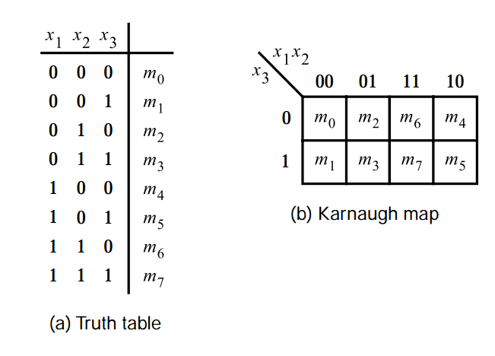
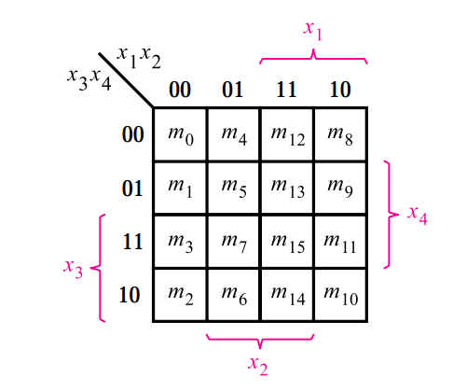
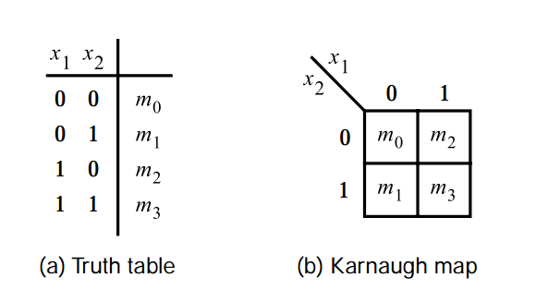
Karnaugh Map
Alternative to truth table
Cells correspond to rows on the truth table
Label squares such that adjacents differ in only one variable so move from 01 to 11 instead
Squares at the end wrap around i.e. squares in top row are adjacent to squares in the bottom row and left most squares are adjacent to right most squares

Slide 17
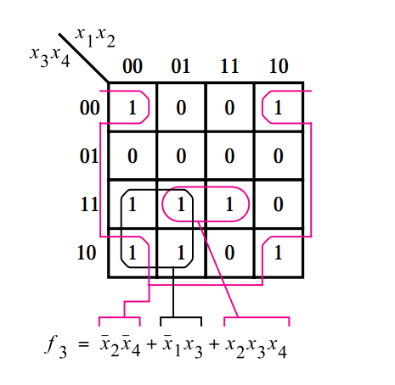
Karnaugh map
Once K-map has been filled with groups of 0s and 1s, SOP expression can be got → OR all squares containing 1
We can then loop groups of 2,4 and 8 adjacent squares containing ones to minimize logic functions

Slide 18
Karnaugh map: Simplification process
When a variable appears in both complemented and uncomplemented form within a loop, that variable is eliminated from the expression. Variables that are the same for all squares of the loop must appear in the final expression
Loops of 2,4,8 eliminate 1,2,3 variables respectively
Steps:
Construct the K map and place 1s in in truth table in corresponding squares
Identify adjacent 1s and loop any isolated 1s.
Loop any pair which is not adjacent to any other 1s
Loop any octet even if it contains smaller looped 1s
Loop any quad that has 1s not yet looped
Loop any pairs including 1s that haven’t yet been looped
Form the OR sum of all terms generated by each loop

Slide 19
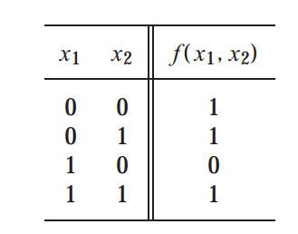
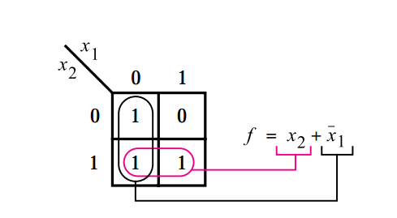
Karnaugh map: Examples
Pink loop:
Output is one irrespective of x₁. value → eliminate x₁.
Output of this term will only have uncomplemented x₂ (since x₂=1)
Black loop:
Output is one irrespective of x₂. value → eliminate x₂.
Output of this term will only have complemented x₁ (since x₁=1)
Source: Brown

Slide 20
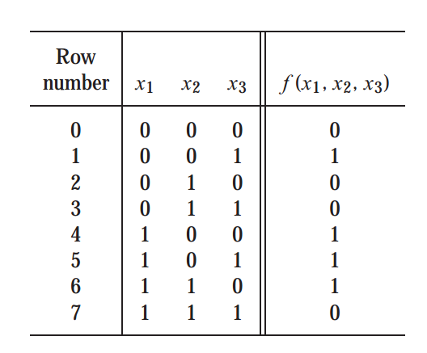
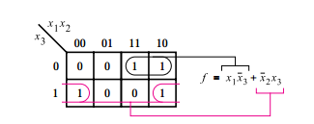
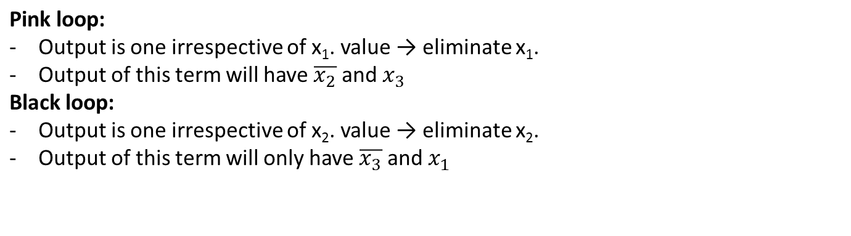
Karnaugh map: Examples
Source: Brown

Slide 21
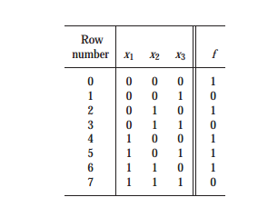
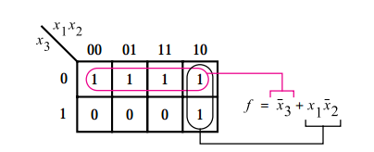
Karnaugh map: Examples
?

Slide 22
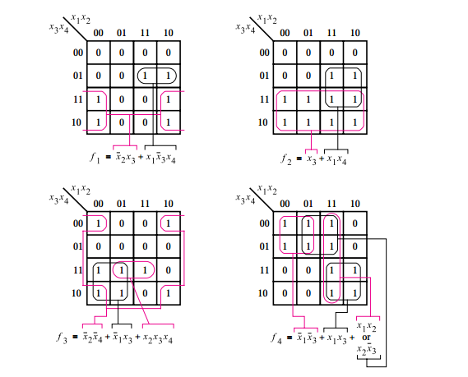
Karnaugh map: Example
Work these out at home!

Slide 23
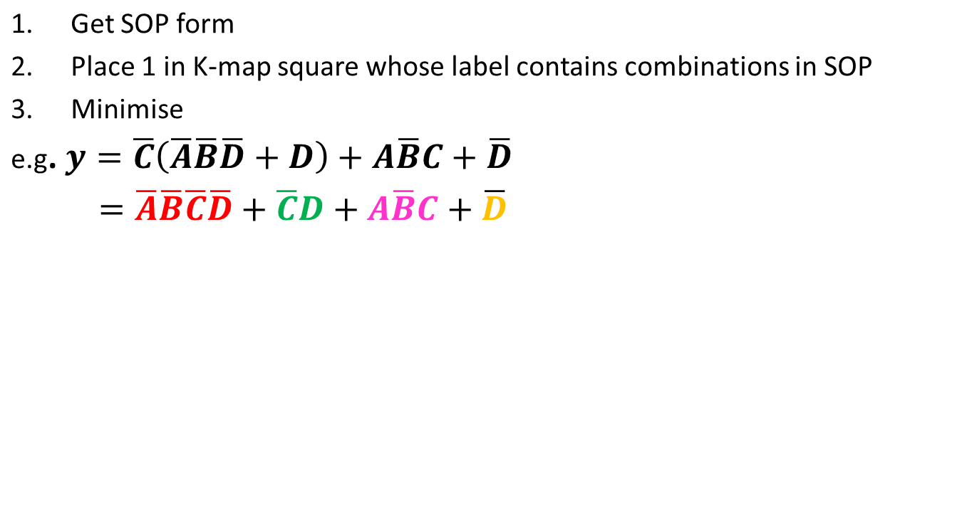
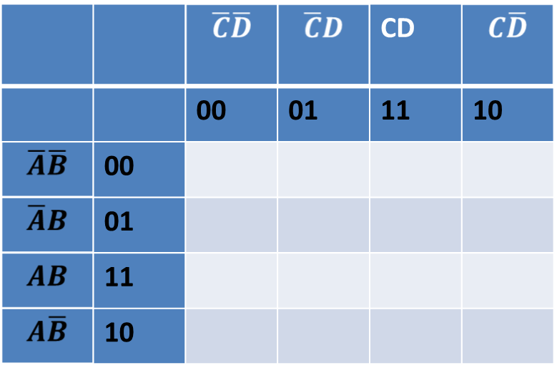
Filling K map from an expression
1
1
1
1
1
1
1
1
1
1
1
0
0
0
1 1

Slide 24
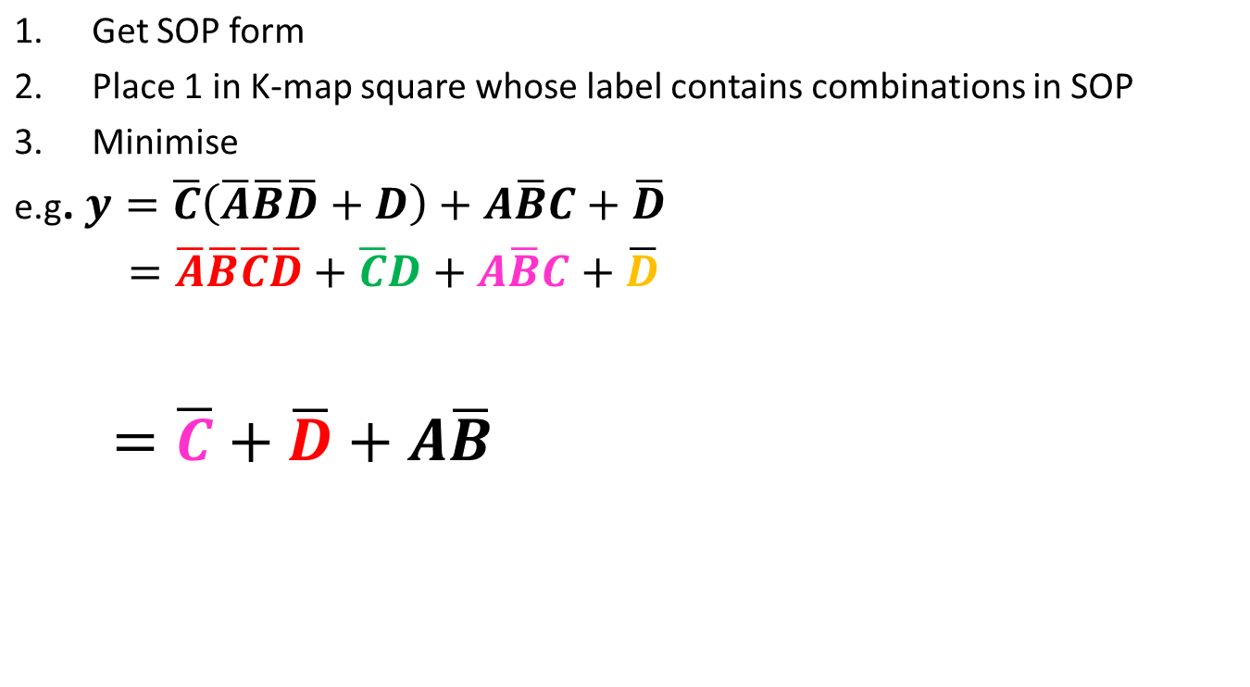
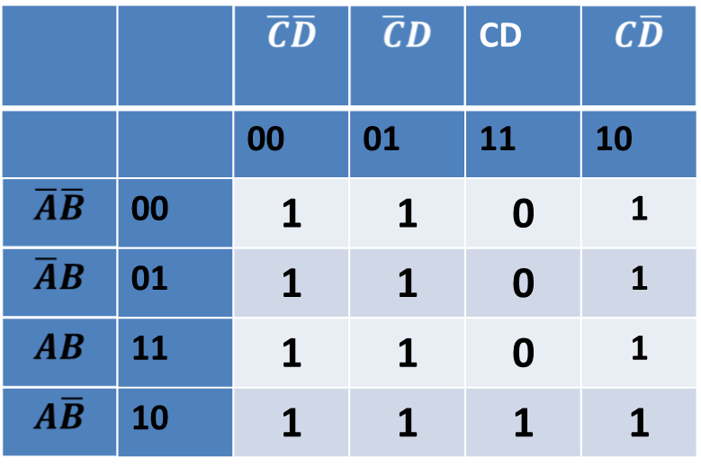
Filling K map from an expression

Slide 25
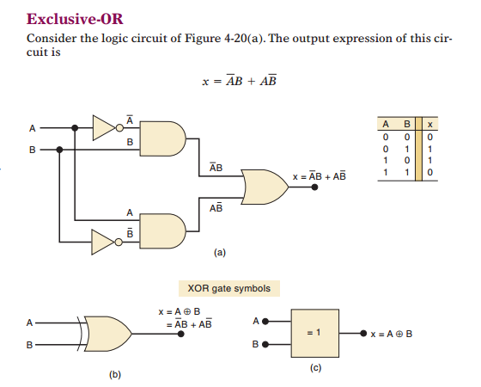
Exclusive-Or ; XOR
Output is high whenever two inputs are opposite
Only 2 inputs

Slide 26
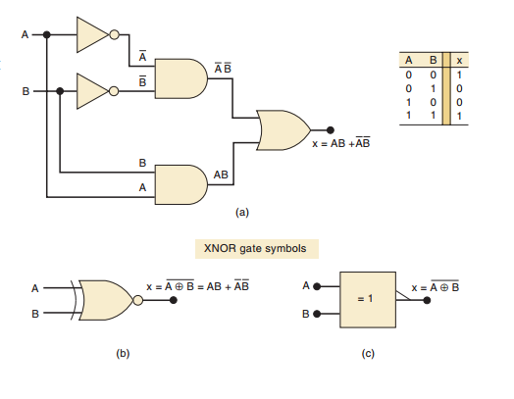
Exclusive-NOR ; XNOR
Output is high when two inputs are at the same level

Slide 27
References/ Handout
Ronald J. Tocci, Neal S. Widmer, Gregory L. Moss, Digital Systems , Principles and Applications, 10th Ed. , Chapter 4
Stephen Brown, Zvonko Vranesic, Fundamentals of Digital Logic with VHDL Design, 3rd Ed, Chapter 1-4

